Slide 1

AI Applications in Robotics
(HUMANOID ROBOTS)
Actuator
Prepared by:
İlyas Aslan: 2230765041
Kasım Aktaş: 2230765031

Slide 2
Contents
Brief history of humanoid robots
Some examples of humanid robots
Working mechanisms related to ai in Humanoid Robots
  Understanding and creating voice
  Visual perception
  Pathfinding
  Touch perception
  Effective movement
Economic aspects of Humanoid Robots
Ethics aspects of Humanoid Robots
Future of humanoid robots

Slide 3

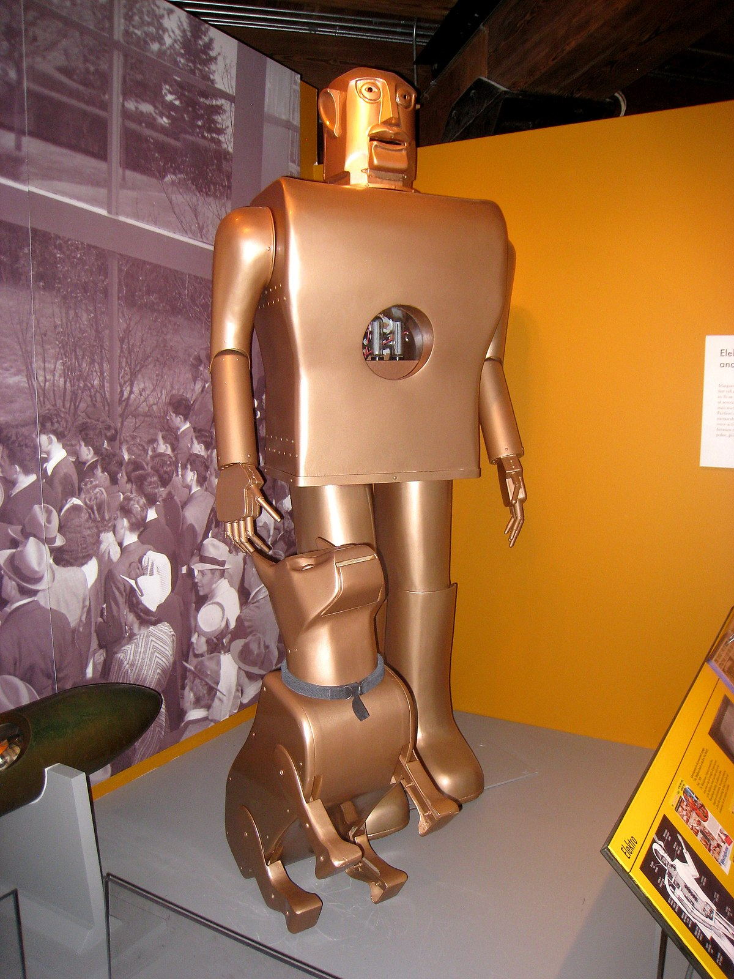
Brief History of Humanoid Robots
First usage of "Robot", Karel Capek
Leonardo da Vinci created a mechanical
robot knight.
First humanoid robot named Elektro
was created by Westinghouse Electric
Corporation.

Slide 4
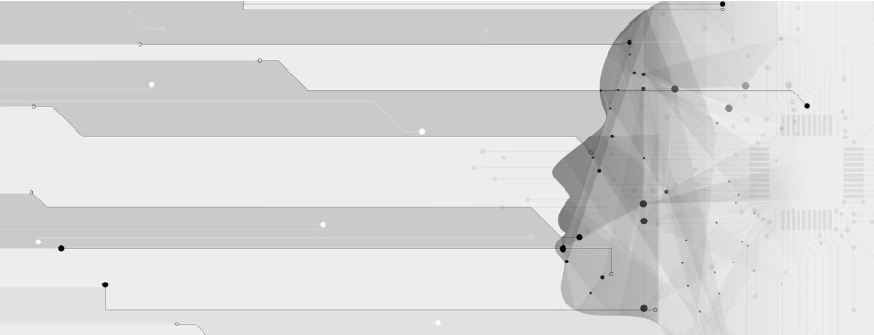
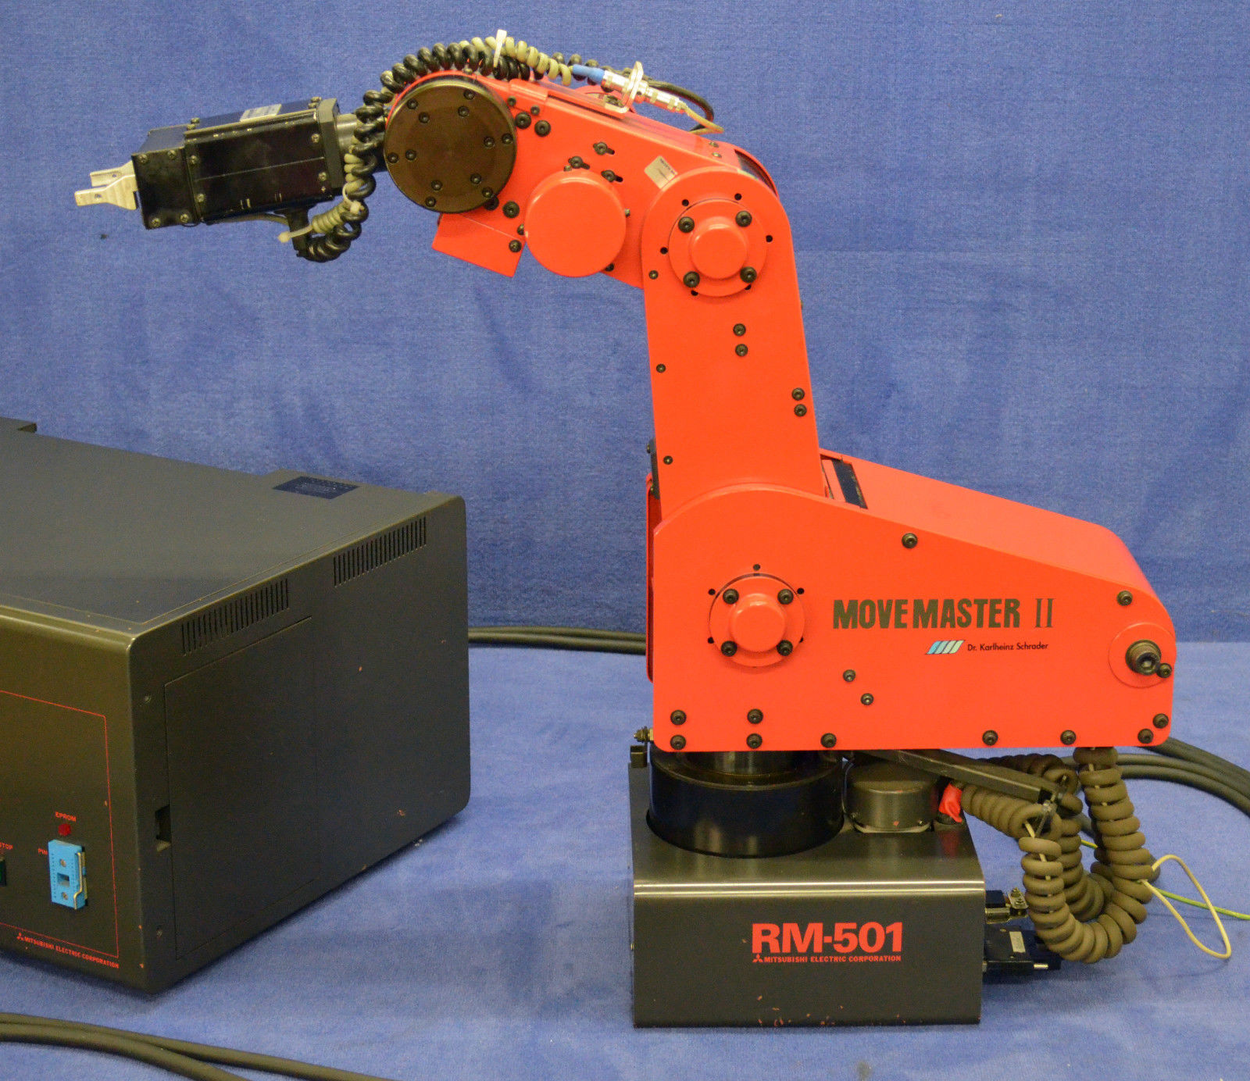
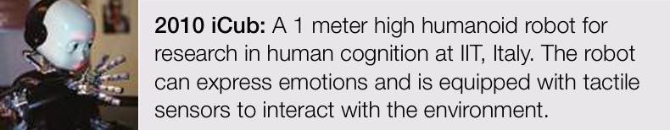
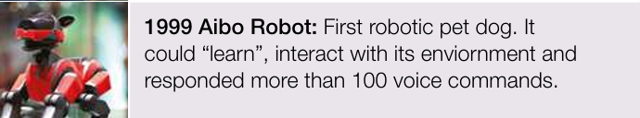
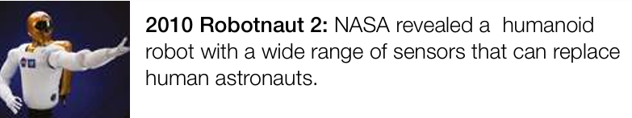
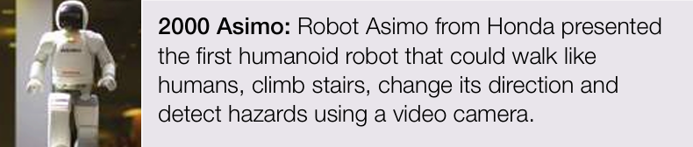
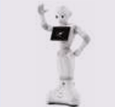
Some Examples of Humanoid Robots
1987 Mitsubishi Movemaster:
It was the first small robotic arm gripper which could perform tasks.
2010 iCub:
A 1 meter high humanoid robot for research in human cognition at IIT, Italy.
2010 Robotnaut 2:
NASA revealed a humanoid robot with a wide range of sensors that can replace human astronauts
1999 Aibo Robot:
First robotic pet dog.
2000 Asimo:
Robot Asimo from Honda presented the first humanoid robot.
2014 Pepper: Japanese company Softbank presented the first robot to be used for customer service.

Slide 5
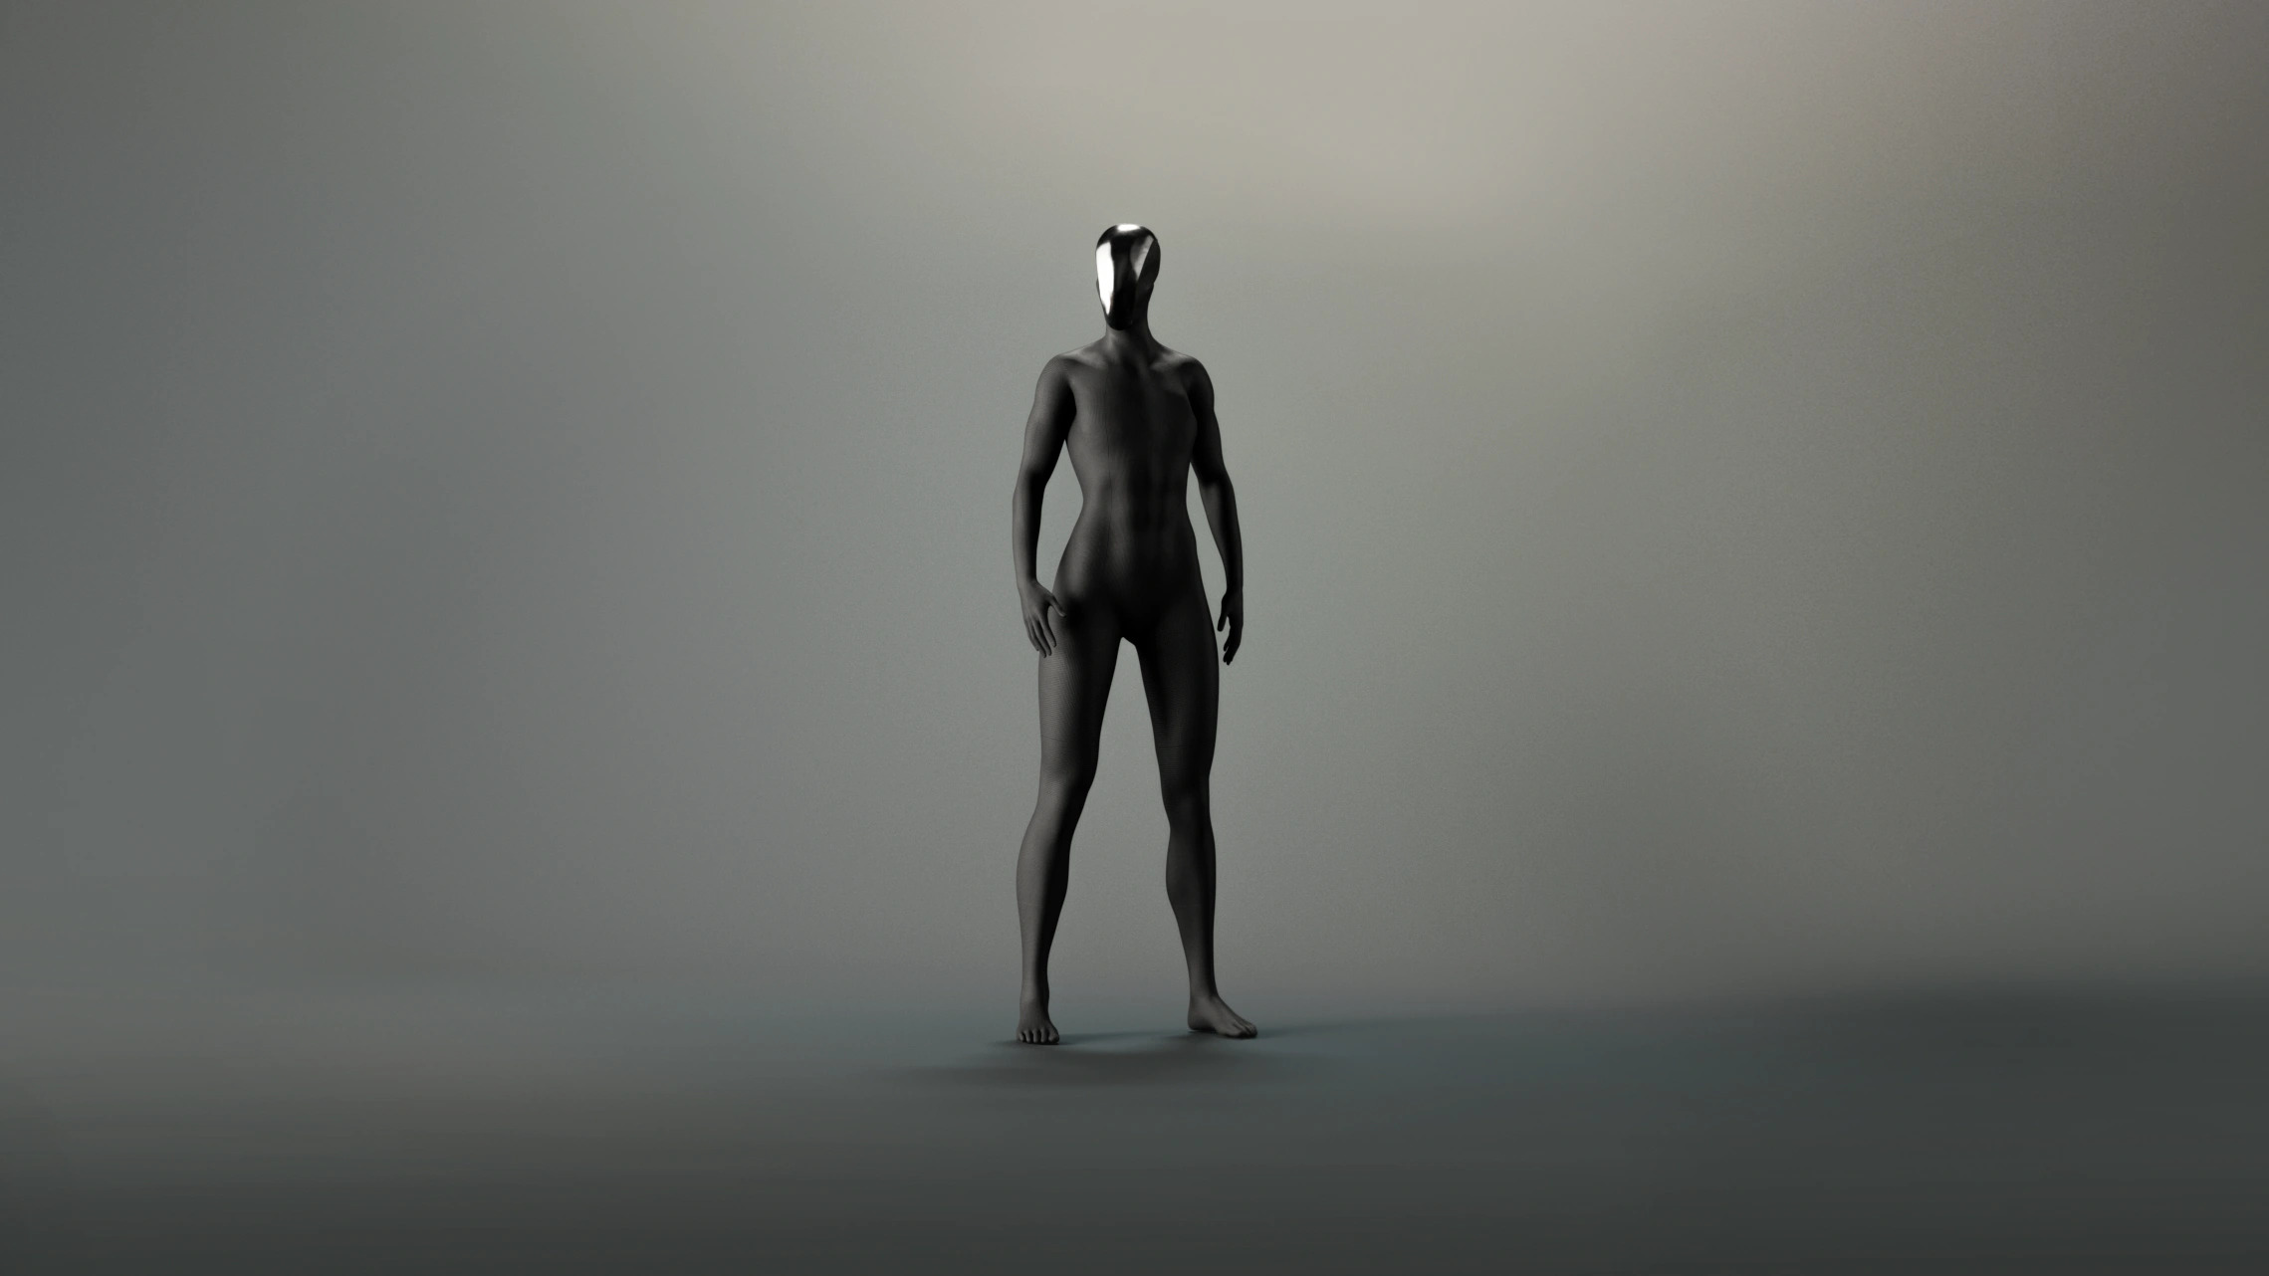
Working Mechanisms Related to Ai in Humanoid Robots
Visual perception
and pathfinding
Understanding and creating voice
Effective movement
Touch perception

Slide 6

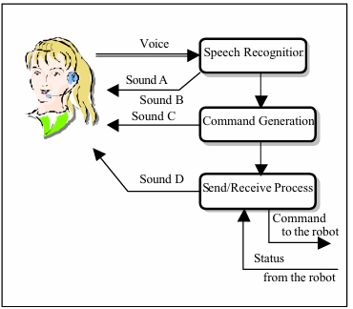

Working Mechanisms Related to Ai in Humanoid Robot
Understanding and Creating Voice

Slide 7

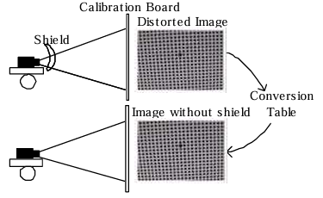
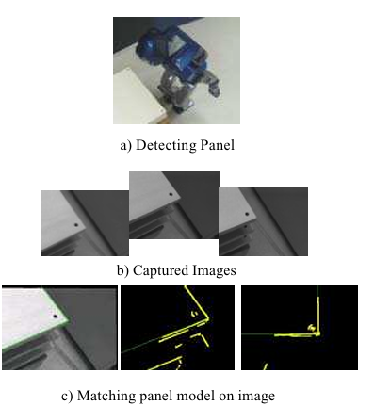
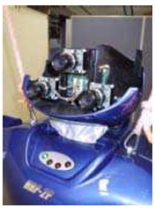
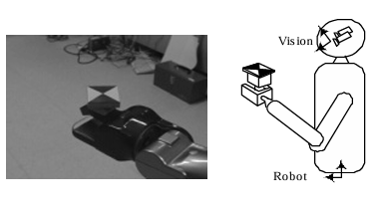
Working Mechanisms Related to Ai in Humanoid Robots
Visual Perception

Slide 8
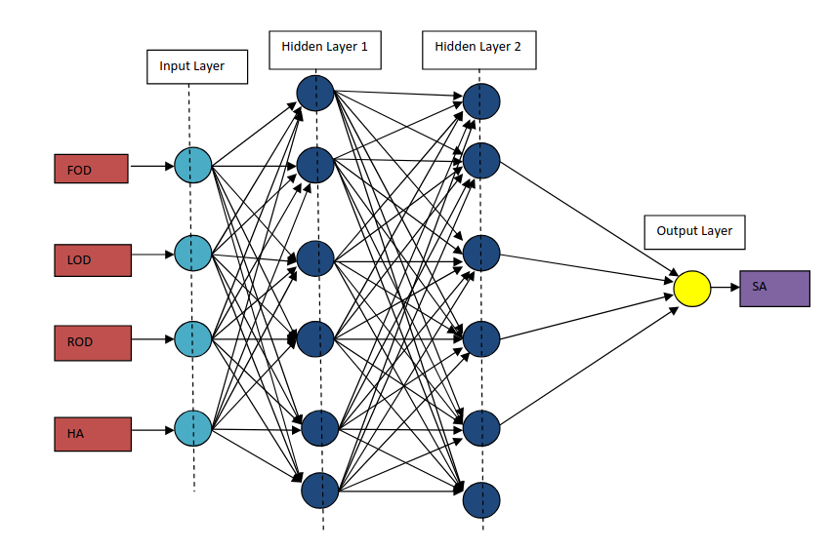
Working Mechanisms Related to AI in Humanoid Robots
Pathfinding
INPUTS
Front obstacle distance [FOD]
Left obstacle distance [LOD]
Right obstacle distance[ROD]
Heading angle [HA]
OUTPUT
Stearing angle [SA]

Slide 9
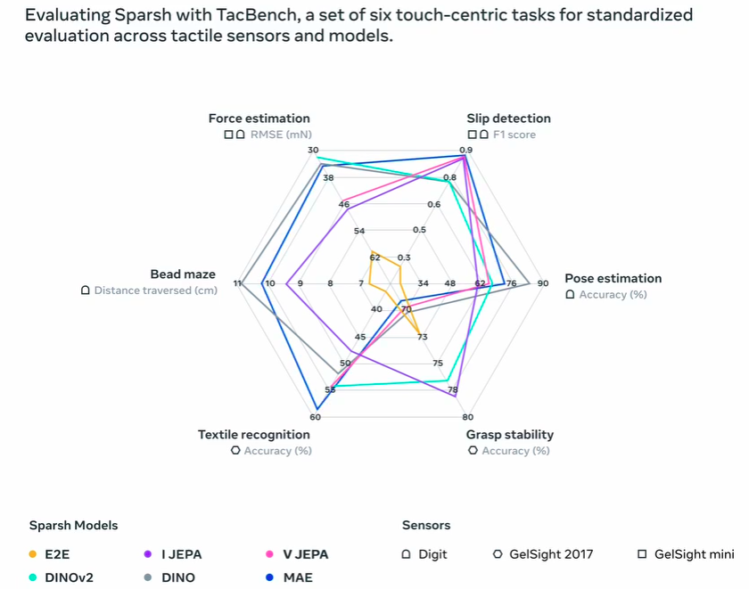
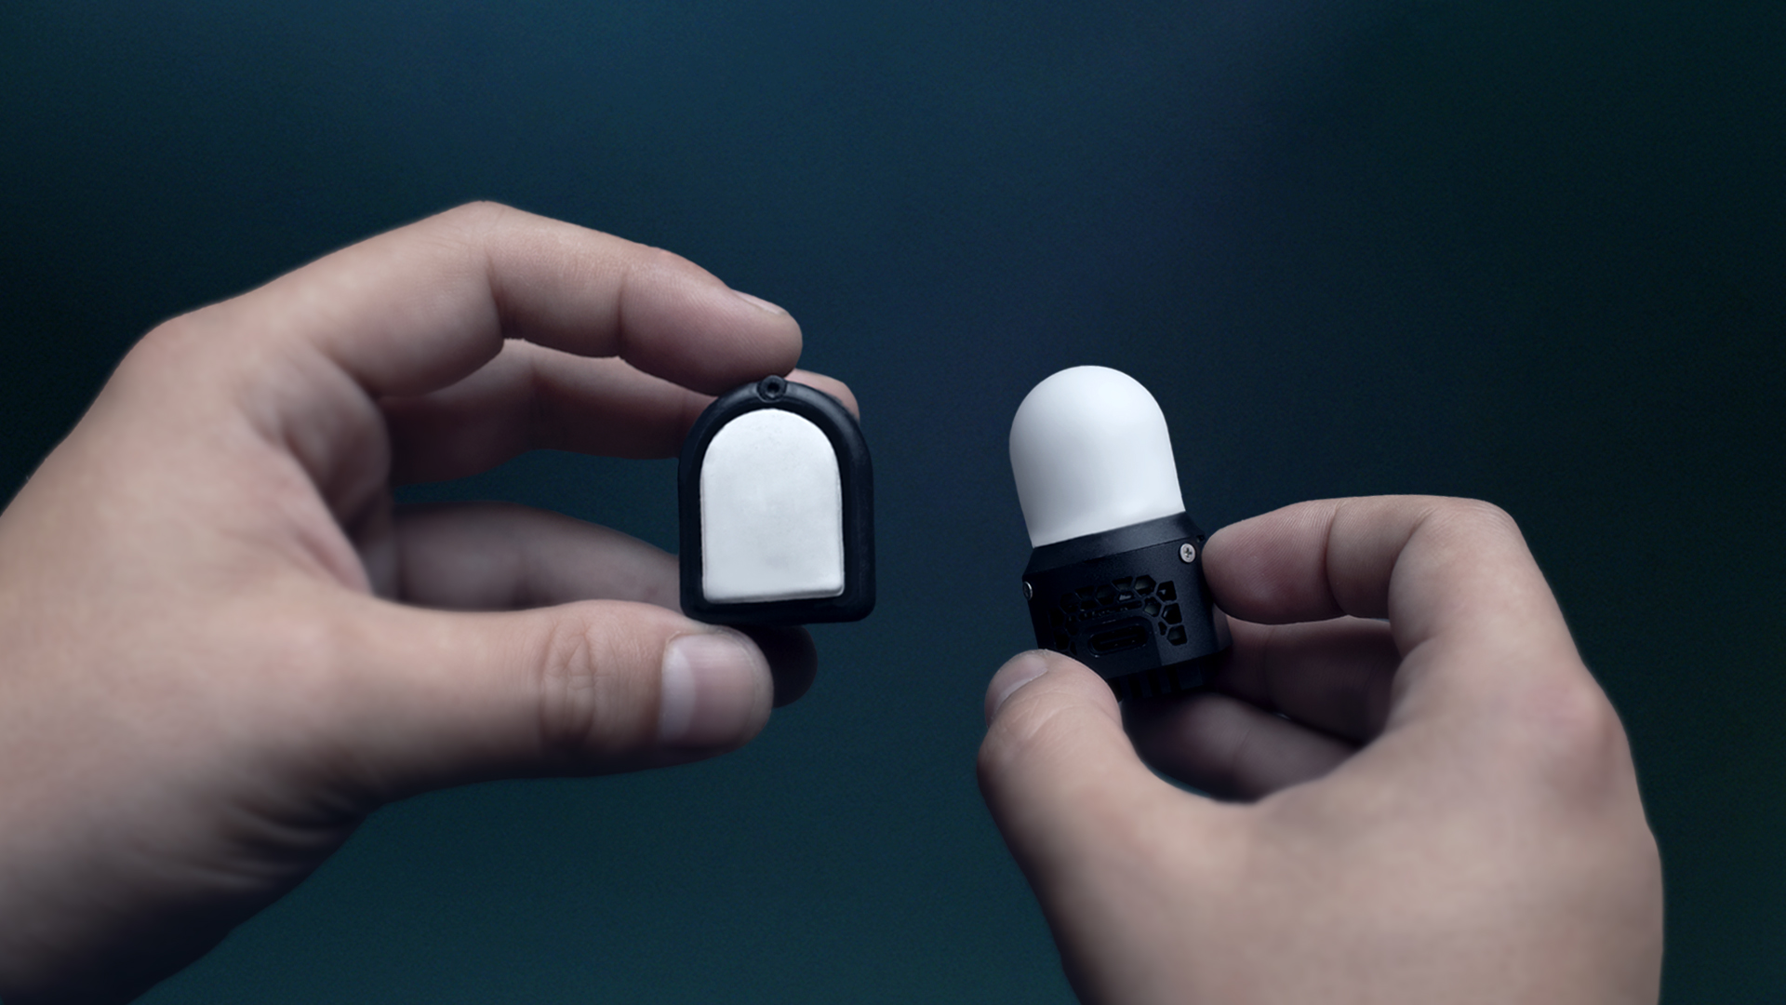
Working Mechanisms Related to AI in Humanoid Robots
Touch perception

Slide 10
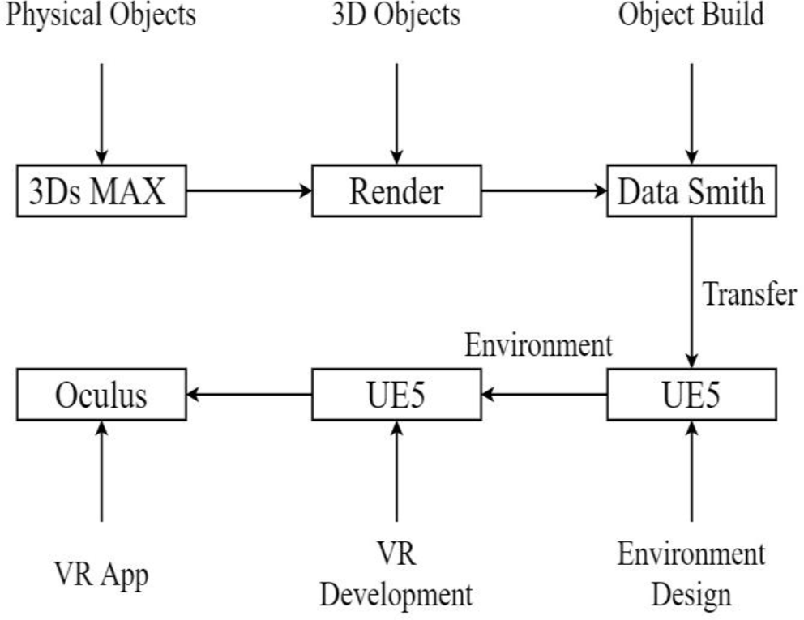
Working Mechanisms Related to AI in Humanoid Robots
Effective movement
Creating Virtual Environment
Advantages of Using Virtual Environment for training Humanoid Robots Movements:
potential clients save ample time normally invested in training robots.
Reduces the space required for robot movements.
Reduces potential robot malfunctions.
Reduces the budget that needs to be spent on training robots.

Slide 11
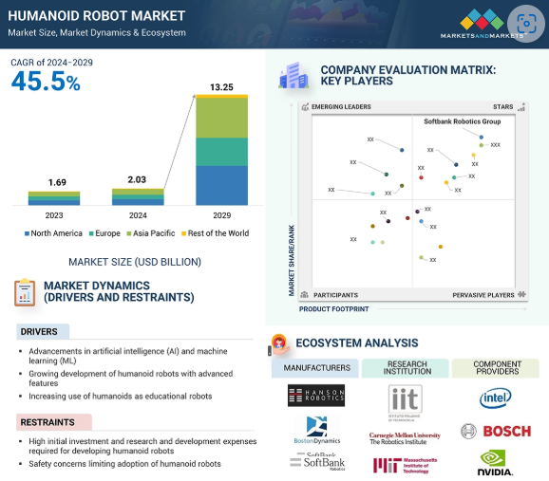
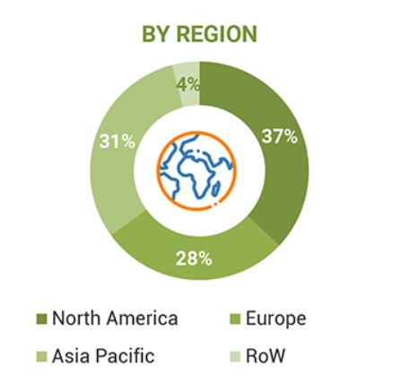
Economic Aspects of Humanoid Robots

Slide 12

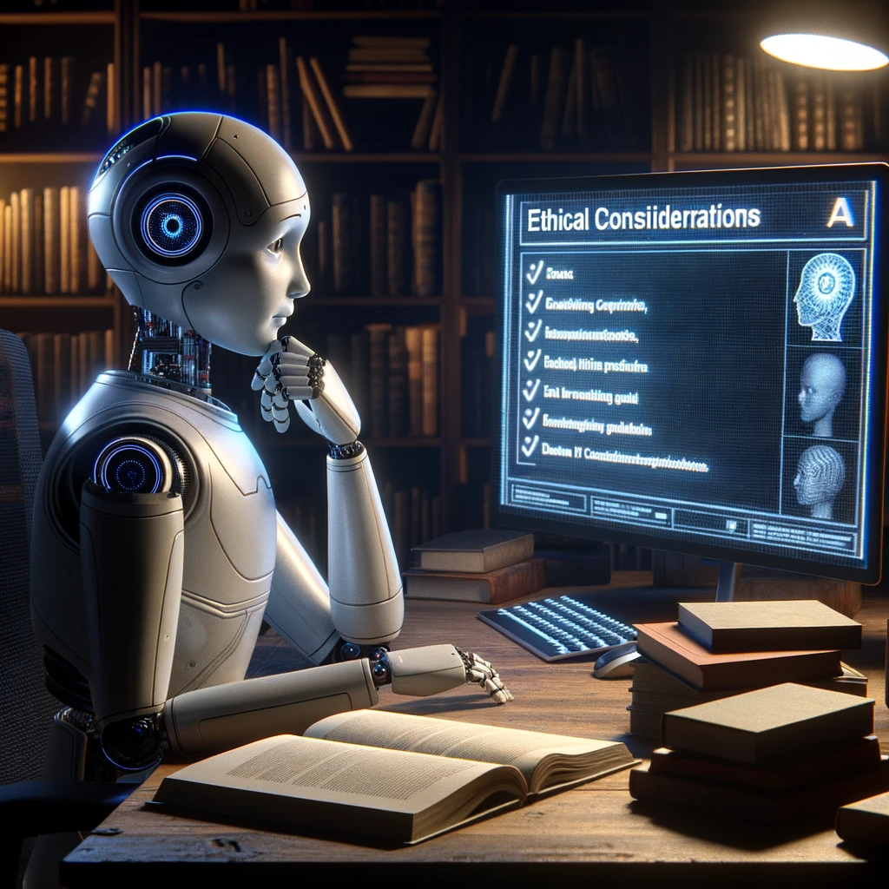
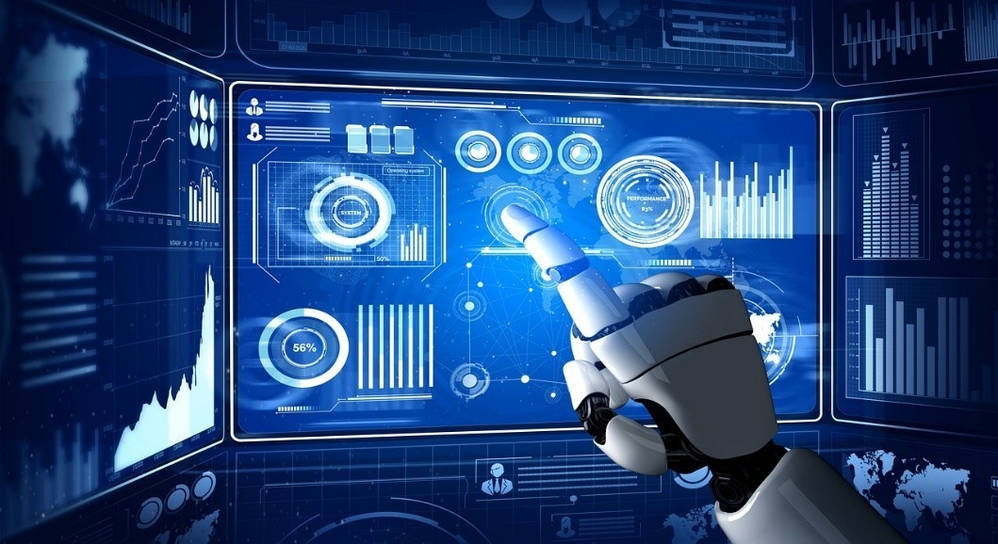
Ethic Aspects of Humanoid Robots

Slide 13
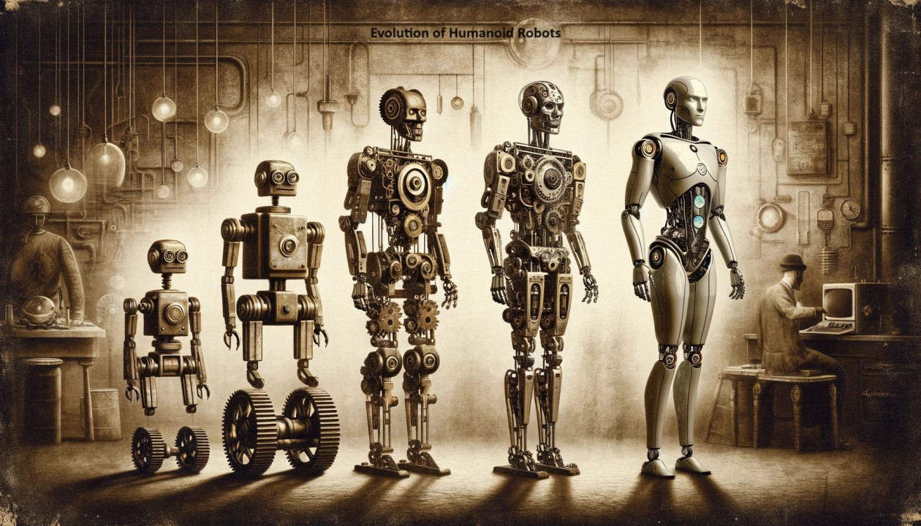
Future of Humanoid Robots

Slide 14
References
,Joe Denny, Mohamed Elyas, Shannon Angel D’costa, Royson Donate D’Souza. Humanoid Robots – Past, Present and the Future, European Journal of Advances in Engineering and Technology, 2016, 3(5): 8-15
Kazuhiko YOKOYAMA, Hiroyuki HANDA, Takakatsu ISOZUMI, Yutaro FUKASE, Kenji KANEKO, Fumio KANEHIRO, Yoshihiro KAWAI, Fumiaki TOMITA , Hirohisa HIRUKAWA, Cooperative Works by a Human and a Humanoid Robot, International Conference on Robotics & Automation Taipei, Taiwan, September 14-19, 2003
Obaid Fareed, M. Irfan Anis. A hyper-realistic virtual environment for robots training, Springer-Verlag GmbH Germany, part of Springer Nature 2024
Javier Andreu Perez, Fani Deligianni, Daniele Ravi and Guang-Zhong Yang , Artificial Intelligence and Robotics 2024
Mária VIRČÍKOVÁ, Peter SINČÁK. Artificial Intelligence in Humanoid Systems, Dept. of Cybernetics and Artificial Intelligence, FEI TU of Kosice, Slovak Republic, 2010
Biswajit Sahoo , Dayal R. Parhi , Priyadarshi Biplab Kumar. Analysis of Path Planning of Humanoid Robots using Neural Network Methods and Study of Possible use of Other AI Techniques, Emerging Trends in Engineering, Science and Manufacturing (ETESM-2018)
Humanoid Robot Market by Component (Hardware, Software), Motion Type (Biped, Wheel Drive), Application (Education and Entertainment, Research and Space Exploration, Personal Assistance and Caregiving) and Region – 2028 2023
Maartje M. A. de Graaf, AnEthical Evaluation of Human–Robot Relationships, Int J of Soc Robotics (2016) 8:589–598 DOI 10.1007/s12369-016-0368-5
Sven Behnke, Humanoid Robots – From Fiction to Reality?, KI-Zeitschrift, 4/08, pp. 5-9, December 2008
Carolina Higuera, Akash Sharma, Chaithanya Krishna Bodduluri, Taosha Fan, Patrick Lancaster, Mrinal Kalakrishnan, Michael Kaess, Byron Boots, Mike Lambeta, Tingfan, Mustafa Mukadam. Sparsh: Self-supervised touch representations for vision-based tactile sensing, FAIR at Meta, University of Washington, Carnegie Mellon University, Equal contribution
Mike Lambeta, Tingfan Wu, Ali Sengül, Victoria Rose Most, Nolan Black, Kevin Sawyer, Romeo Mercado, Haozhi Qi. Digitizing Touch with an Artificial Multimodal Fingertip, FAIR at Meta, Learning, Adaptive Systems, and Robotics (LASR) Lab, TU Dresden, The Centre for Tactile Internet with Human-in-the-Loop (CeTI), University of California, Berkeley, October 31, 2024

